Slide 1

Customer Segmentation
Presenter – GAURAV SRIVASTAVA (Amity University)

Slide 2

INTRODUCTION & MOTIVATION OF THE PROJECT
INTRODUCTION:-
Customer Segmentation is one of the hottest demand for any marketers.
The process of grouping customers into sections of individuals who share common characteristics is called Customer Segmentation.
This segmentation enables marketers to create targeted marketing messages for a specific group of customers which increases the chances of the person buying a product.
Notes:
Notes to presenter:
What is your purpose for sharing this reflection?
Is it at the end of a unit or project?
Are you sharing this reflection, at the attainment of a learning goal you set for yourself?
Is it at the end of a course?
State your purpose for the reflection or even the purpose of the learning experience or learning goal. Be clear and be specific in stating your purpose.

Slide 3
Introduction & Motivation of the Project (Cont’d…)
INTRODUCTION:-
Customer segmentation is the action of breaking the customer base into groups depending on demographic, psychographic, etc.
Customer Segmentation is also known as Market Basket Analysis. It can be a powerful means to identify unsatisfied customer needs.
MOTIVATION:-
We have abundant of data for customers from various marketers, but most of the data we are not using for productive marketing. There comes the motivation that we can apply the customer segmentation technique to utilize those data in a effective way to satisfy the unhappy customers and increase the marketers services.

Slide 4
Introduction & Motivation of the Project (Cont’d…)
MOTIVATION:-
In supermarket malls through membership cards, we can have some basic data about our customers like customer-id, age, gender, annual income and spending score.
Spending Score is something we can assign to the customer based on our defined parameters like customer behaviour and purchasing data.
Motivation of the project is when there is a need to do customer segmentation, Machine learning is the best approach.

Slide 5

PROBLEM STATEMENT
The problem statement is formulated as “You are owing a market place and through membership cards, you have some basic data about your customers like Customer ID, age, gender, annual income and spending score. You want to understand the customers like who are the target customers, so that the sense can be given to marketing team and plan the strategy accordingly.”
To increase the marketing strategies and product deployment the problem is to identify below points:
Appropriate product pricing.
Develop customized pricing campaign.
Design an optimal distribution strategy.
Choose specific product features for deployment.
Prioritize new product development effort.
Notes:
Notes to presenter:
Description of what you learned in your own words on one side.
Include information about the topic
Details about the topic will also be helpful here.
Tell the story of your learning experience. Just like a story there should always be a beginning, middle and an end.
On the other side, you can add a graphic that provides evidence of what you learned.
Feel free to use more than one slide to reflect upon your process. It also helps to add some video of your process.

Slide 6
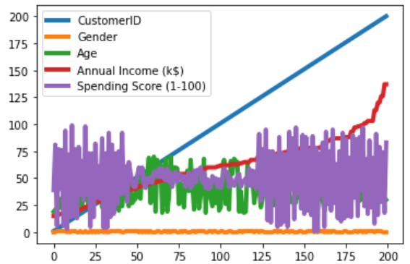
Problem Statement (Cont’d…)
All the above problems completely depend upon how we can identify the customers. As we have the abundant of customer data, still there is no visibility to use it. In our dataset we have data (Customer ID, Gender, Age, Annual Income, Spending Score) as presented below:
This doesn’t give the clear picture of customers, so here we will go with customer segmentation technique to figure out the actual view of the data.

Slide 7

PROPOSAL OF MACHINE LEARNING MODEL
1
2
Descriptive
Analysis
Diagnostic
Analytics
01
04
02
4
3
03
Prescriptive
Analytics
Predictive
Analytics
Notes:
Notes to presenter:
What did you think at first?
What obstacles did you encounter along the way?
How did you overcome those obstacles?
What images can you add to support your process?
This SmartArt allows you add images and text to help outline your process. If a picture is worth a thousand words, then pictures and words should help you communicate this reflection on learning perfectly! You can always click on Insert>SmartArt to change this graphic or select the graphic and click on the Design contextual menu to change the colors.
Feel free to use more than one slide to reflect upon your process. It also helps to add some video of your process.

Slide 8

Proposal of Machine Learning Model (Cont’d…)
Customer Segmentation with Machine Learning is the process of analysing customer features (such as age, education, interests, and spending habits) to select those customers who are more prone to a target product or service.
Machine learning can be used to memorize patterns, visualize cluster and give prediction of result to segment customer that are present in the training data.
Companies from many different industries have realized that Machine Learning can select potential clients much better than traditional methods, which allows the design of more effective marketing.
4
Prescriptive Analytics
3
2
Predictive Analytics
1
Diagnostic Analytics
Descriptive Analysis

Slide 9
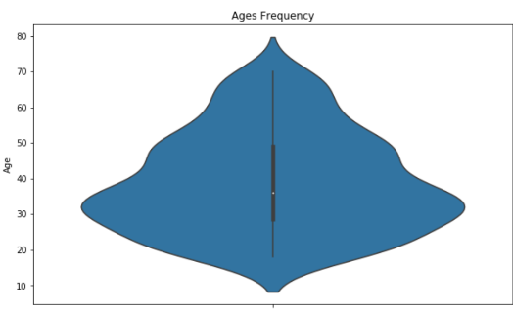
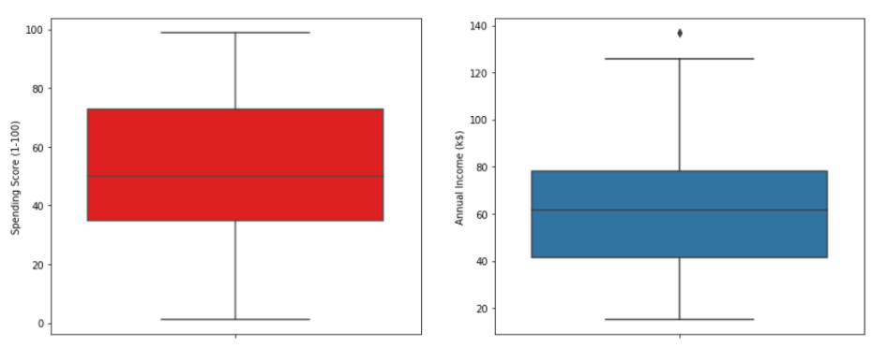
Proposal of Machine Learning Model (Cont’d…)
Machine learning helps in many ways to do research on data.
Here we can easily see the segregation of the customers based on their ages and spending scores.
Descriptive Analysis & Diagnostic Analytics

Slide 10
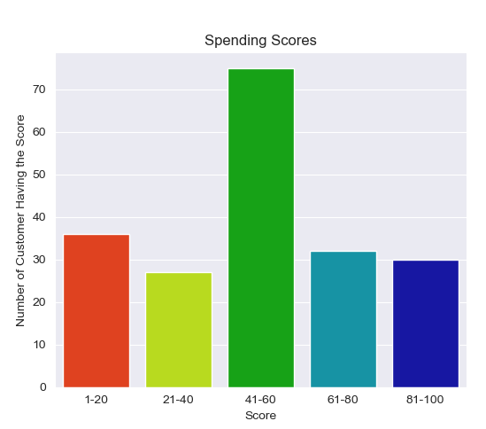
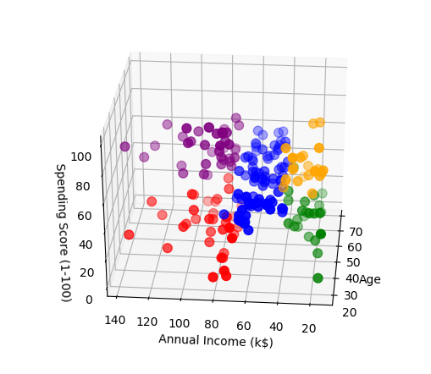
Proposal of Machine Learning Model (Cont’d…)
Predictive & Prescriptive analysis using Machine learning can help to predict the customer with their spending scores and also the valuable customers.
Predictive Analysis & Prescriptive Analytics

Slide 11
Proposal of Machine Learning Model (Cont’d…)
Machine Learning Model:-
Customer Segmentation is one the most important applications of unsupervised learning. Using clustering techniques, companies can identify the several segments of customers allowing them to target the potential user base.
K-Means clustering algorithm is the essential algorithm for clustering unlabeled dataset.
While using the k-means clustering algorithm, the first step is to indicate the number of clusters (k) that we wish to produce in the final output. The algorithm starts by selecting k objects from dataset randomly that will serve as the initial centers for our clusters.

Slide 12
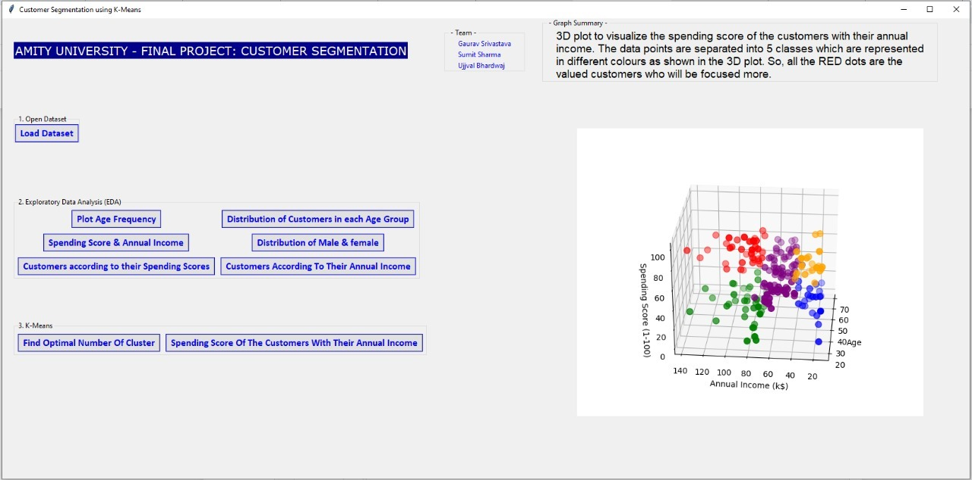
Result
The general population and customer population have been compared and segmented using an unsupervised learning algorithm. We were able to determine which clusters have more customers and which potential clusters to have probable customers are.
By using this model we can target the customers with whom we can start marketing strategy [easy to converse].
This segmentation enables marketers to create targeted marketing messages for a specific group of customers which increases the chances of the person buying a product. It allows them to create and use specific communication channels to communicate with different segments to attract them.
Notes:
Notes to presenter:
Description of what you learned in your own words on one side.
Include information about the topic
Details about the topic will also be helpful here.
Tell the story of your learning experience. Just like a story there should always be a beginning, middle and an end.
On the other side, you can add a graphic that provides evidence of what you learned.
Feel free to use more than one slide to reflect upon your process. It also helps to add some video of your process.

Slide 13

CONCLUSION
3D plot to visualize the spending score of the customers with their annual income.
3D plot to visualize the spending score of the customers with their annual income. The data points are separated into 5 classes which are represented in different colours as shown in the 3D plot. So, all the RED dots are the valued customers who will be focused more.
Notes:
Notes to presenter:
Description of what you learned in your own words on one side.
Include information about the topic
Details about the topic will also be helpful here.
Tell the story of your learning experience. Just like a story there should always be a beginning, middle and an end.
On the other side, you can add a graphic that provides evidence of what you learned.
Feel free to use more than one slide to reflect upon your process. It also helps to add some video of your process.

Slide 14
END OF PRESENTATION
THANK YOU.

